Slide 1

Introduction to Android Application Development
By: Shreyas Sharad Patil

Slide 2
What is Android?
Google’s Android is an Open Source platform that currently available on wide variety of Smartphones.
Based on Linux Kernel.
Basically developed for touch screen devices.
Android SDK Provides tools and APIs to development applications for Android.

Slide 3
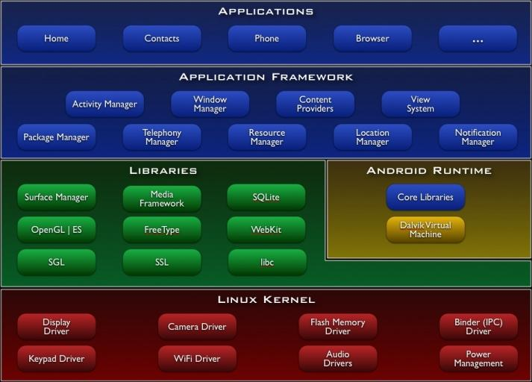
Android Architecture

Slide 4
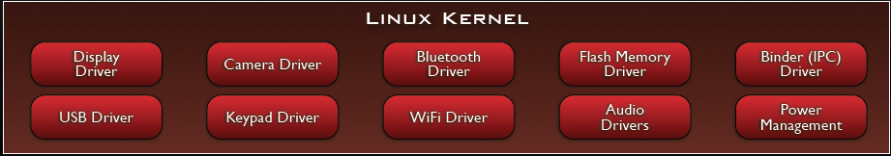
Android Architecture
Linux Kernel:
Note that Android based on a Linux kernel not a Linux OS
Supplies Security, Memory management, Process management, Network stack and Driver model
Acts as an abstraction layer between the hardware and the rest of the software stack

Slide 5
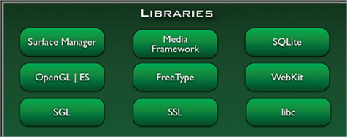
Android Architecture
Libraries:
Run in system background
System C library, the standard C system library, tuned for embedded Linux-based devices
Media Libraries, support playback and recording of many popular audio and video formats, as well as image files, including MPEG4, H.264, MP3, AAC, AMR, JPG, and PNG
Surface Manager, manages access to the display subsystem and seamlessly composites 2D and 3D graphic layers from multiple applications
WebKit, a modern web browser engine which powers both the Android browser and an embeddable web view
SGL, the underlying 2D graphics engine
3D libraries, an implementation based on OpenGL ES 1.0 APIs
FreeType , bitmap and vector font rendering
SQLite , a powerful and lightweight relational database engine

Slide 6
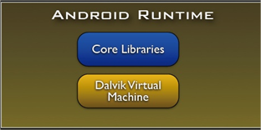
Android Architecture
Android Runtime:
The core of Android platform
Dalvik Virtual Machine
Register-based
Executes files in the Dalvik Executable (.dex) format
Java core Libraries
Provides most of the functionality of the Java programming language.
The functions of Java core libraries rely on the Dalvik VM and the underlying Linux kernel
Multiple Dalvik VMs may run at the same time
Every Android application runs in its own process, with its own instance of the Dalvik virtual machine
The "dx" tool in Android SDK can transform compiled JAVA class into the .dex format

Slide 7
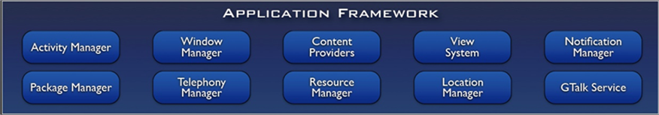
Android Architecture
Android Framework:
Simplify the reuse of components
Applications can publish their capabilities and any other application may then make use of those capabilities
Applications is a set of services and systems, include
Views system, content providers, resources manager and so on

Slide 8

Android Architecture
Applications:
A set of core applications shipped with Android platform
an email client, SMS program, calendar, maps, browser, contacts, and others
All written in Java
Our applications are in the same level as these applications

Slide 9
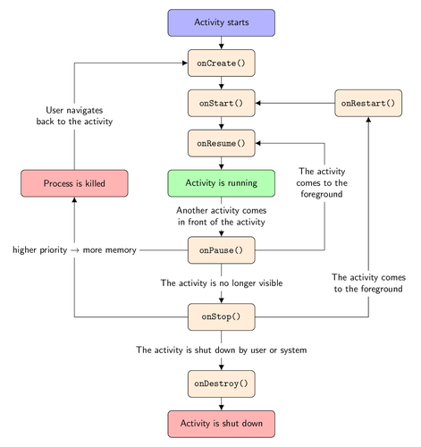
Android Lifecycle

Slide 10
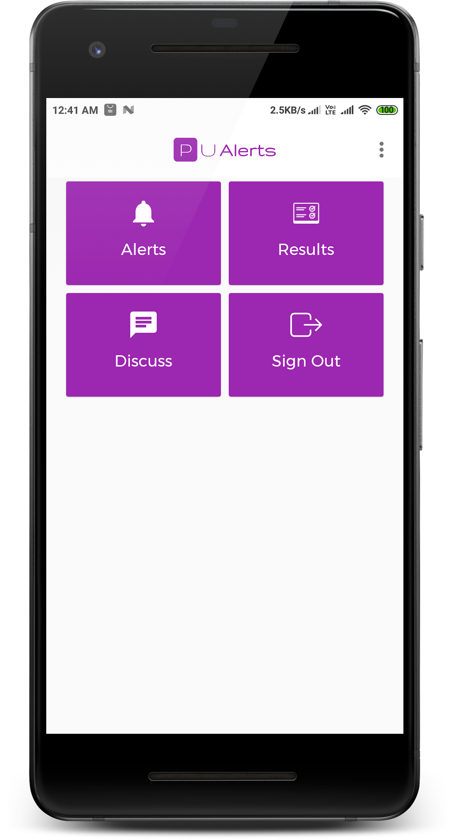
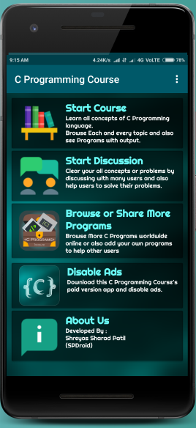
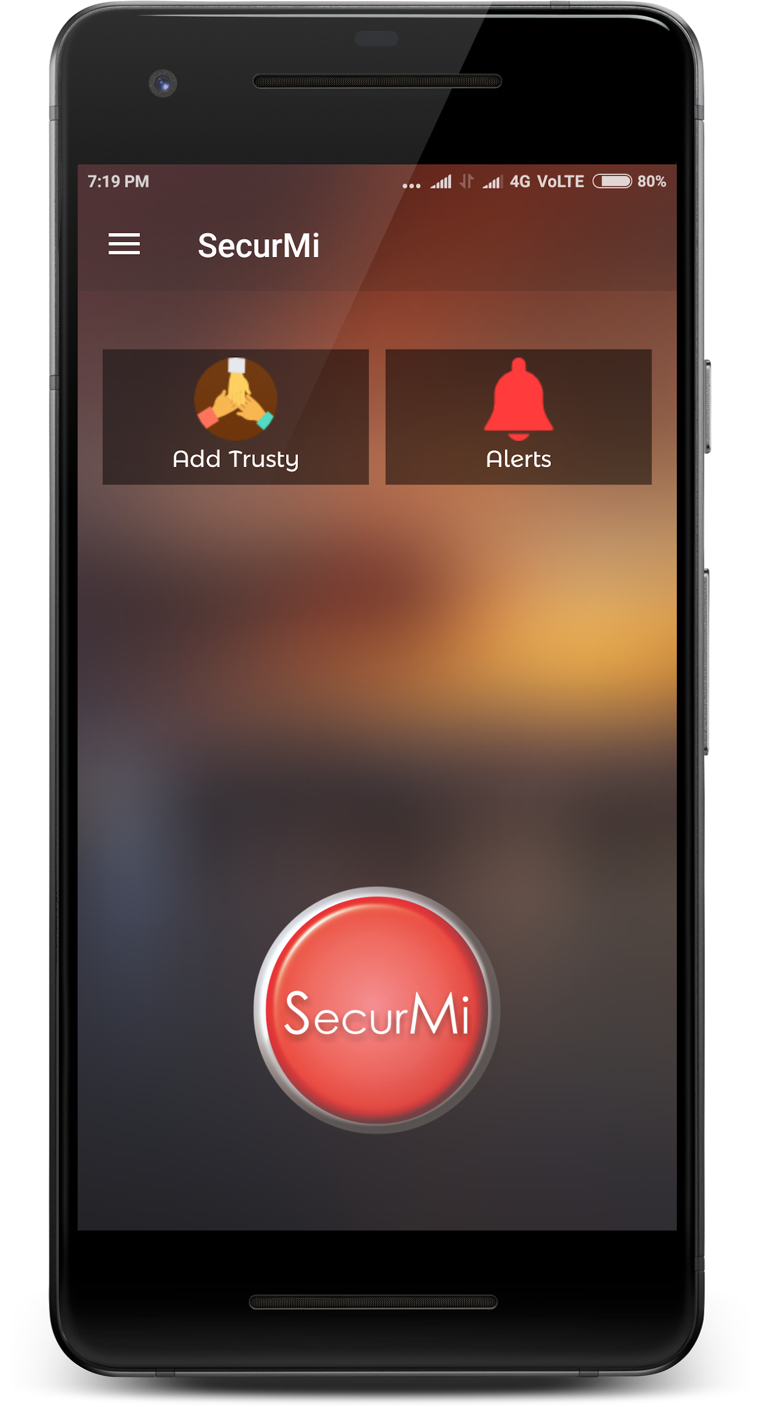
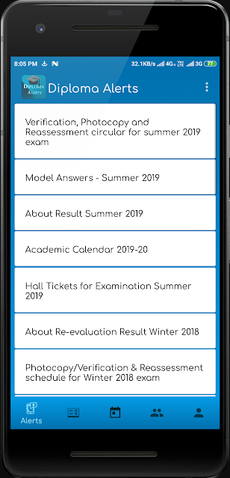
Some of My Android Apps on Google Play Store
PU Alerts
C Programming Course
SecurMi
Diploma Alerts

Slide 11

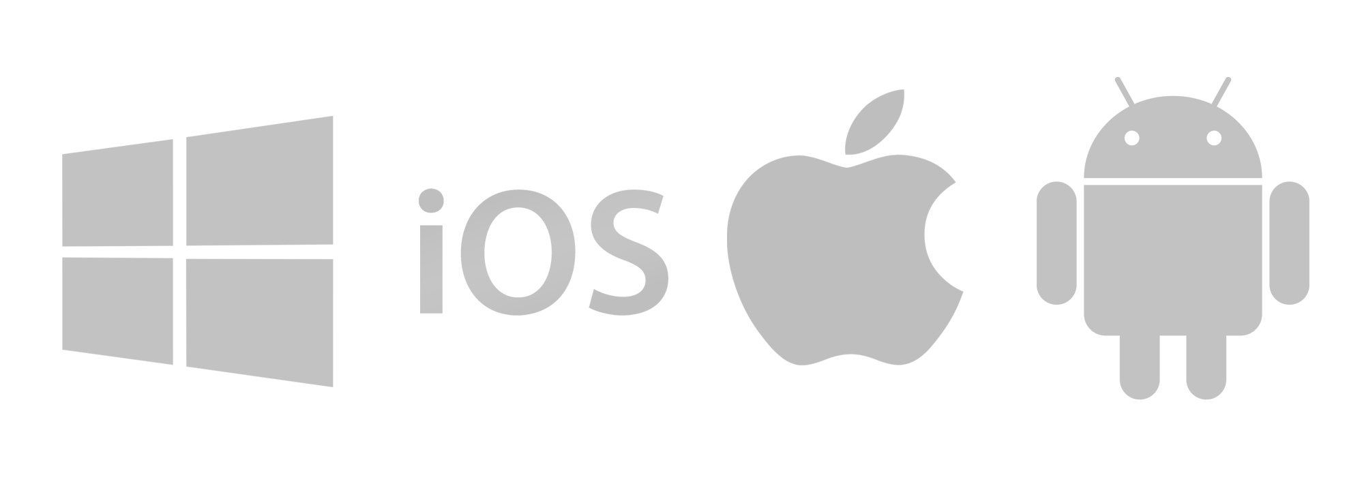
Different Technologies to Develop Android Apps
Native Android Development:
Java/Kotlin/C++. Kotlin is now official supported language by Google.
Most of the apps developed using native app development.
Official Android SDK is provided by Google itself for development.
Hybrid App Development:
Cordova/PhoneGap: Old method of development. Uses HTML, JavaScript, etc.
ReactJS: Uses Reactive Java framework. Developed by Facebook. E.g. Instagram.
Flutter: New Technology by Google. Uses Dart language. Trending now a days.

Slide 12
Let’s Start Native Android Development
What is Required:
Minimum 4GB RAM, 8GB Recommended.
Java JDK 1.8+
Android Studio 3.5
Latest Android SDK

Slide 13
What is Java JDK?
The Java Development Kit (JDK) is one of three core technology packages used in Java programming, along with the JVM (Java Virtual Machine) and the JRE (Java Runtime Environment). It's important to differentiate between these three technologies, as well as understanding how they're connected:
The JVM is the Java platform component that executes programs.
The JRE is the on-disk part of Java that creates the JVM.
The JDK allows developers to create Java programs that can be executed and run by the JVM and JRE.

Slide 14
What is Android SDK?
The Android SDK (software development kit) is a set of development tools used to develop applications for Android platform. The Android SDK includes the following:
Required libraries
Debugger
An emulator
Relevant documentation for the Android application program interfaces (APIs)
Sample source code
Tutorials for the Android OS

Slide 15

Introduction Android Studio
-An IDE to develop powerful Android apps

Slide 16
Features of Android Studio
Powerful editor.
Smart suggestions.
Smart Layout editor.
With Gradle automation tool.
Supports Maven.
Most of the work is automated.
Simple to use.

Slide 17
Let’s Start Practical.
Let’s Play with Android Studio….

Slide 18
Thank You!
Shreyas Sharad Patil
https://shreyaspatil.me
+91-7767084933

